Slide 1
Students as co-creators….
who owns their voice?

Slide 2
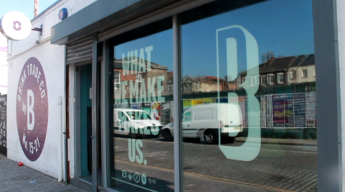
Early
recovery from substance misuse
local
infrastructure
across education,
treatment &
recovery
Safe &
supportive
environment
Back from the Brink
Students
as
active partners
Informal/
Flexible
Integration
&
progression

Slide 3
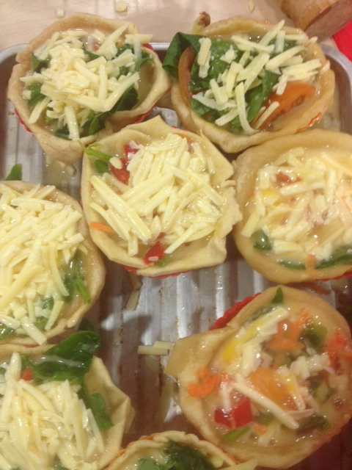
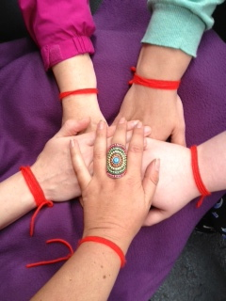
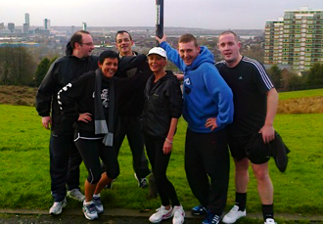

Slide 4
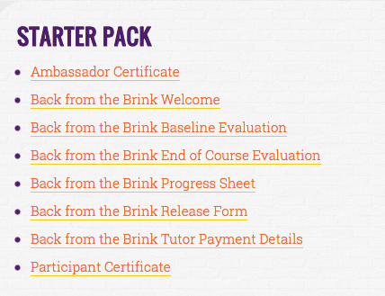
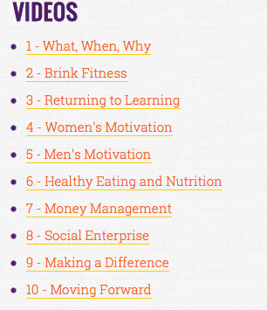
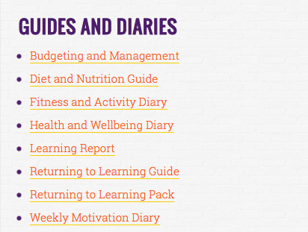

Slide 9
Motivation
Application
Awareness/perception
‘Agency’/
Ownership
Players?
Vulnerability/informed
consent?
Copyright/
Licensing?
Sustainability,
Legacy?

Slide 10
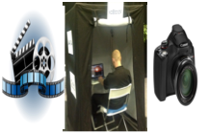
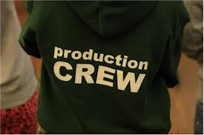
Individual Films
10 Chapters
New material
Community Social
Action Research
‘Bottom Up’
Dr Lucy Webb
Dr Nigel Cox

Slide 11
Amanda Clayson
amanda@voiceboxinc.co.uk
07734204564
VoiceBox-Inc
CURIOSITY
cultivate possibility
and exploration
CONNECTION
nurture learning exchange
and legacy
CO-CREATION
enable active participation and recognition for all

